Slide 2








G
O
M
R
I
G
O
D
N
O
N
!
Gia Khanh Primary School
Welcome to
our class 4

Slide 3
Saturday, April 25th 2020.
UNIT 12: LESSON 3 (4,5) P17

Slide 4
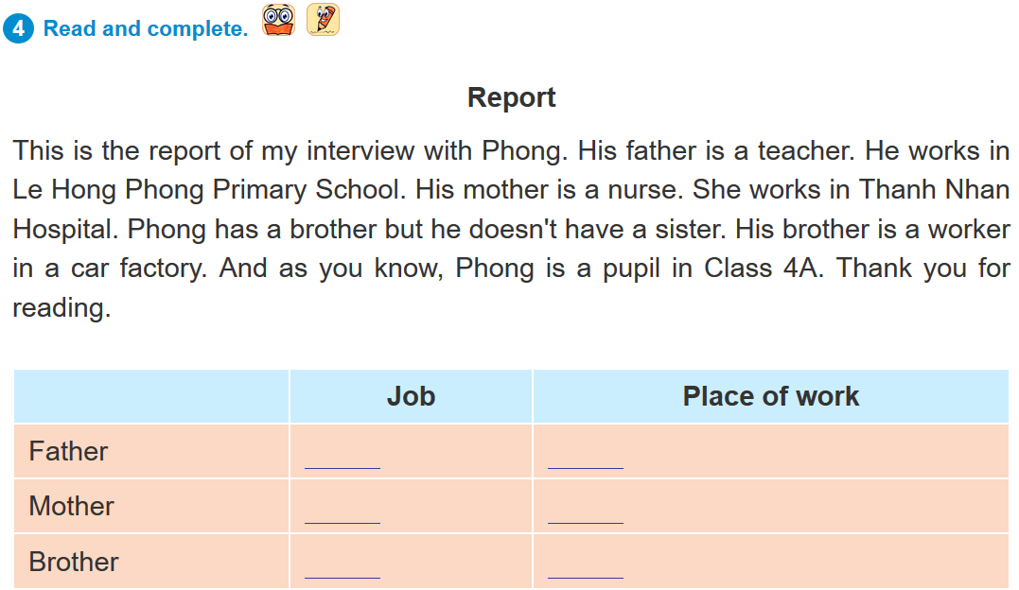
teacher
Le Hong Phong Primary School
nurse
Thanh Nhan Hospital
worker
car factory

Slide 5
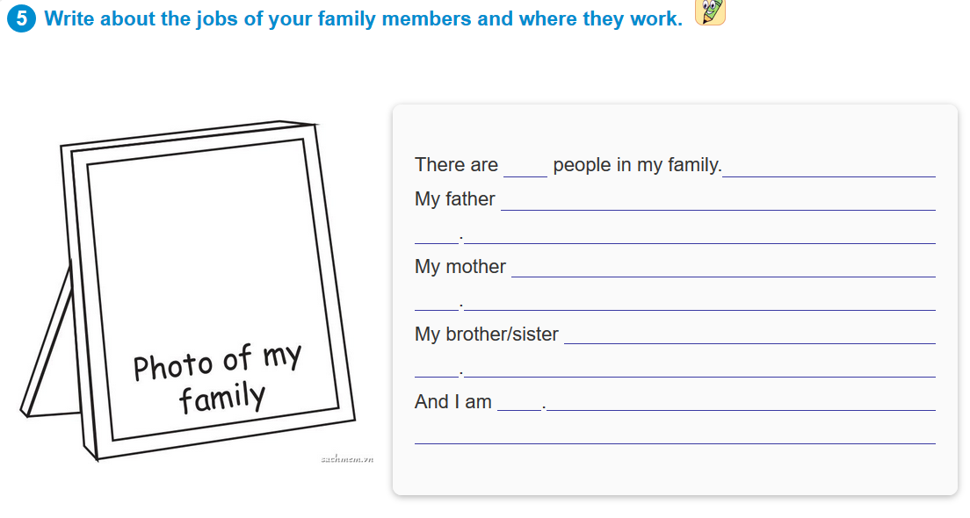
There are 4 people in my family. My father is a farmer. He works in a field. My mother is a worker. She works in a factory. My sister is a student. She studies at school. And I am a teacher. I work at school.

Slide 6
NEW WORD

Slide 8

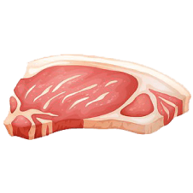
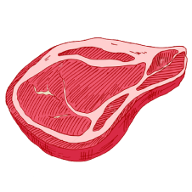
Food: đồ ăn
beef: thịt bò
pork: thịt lợn
fish: cá, món cá

Slide 9

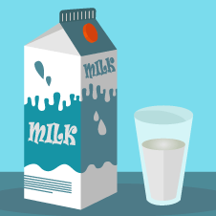
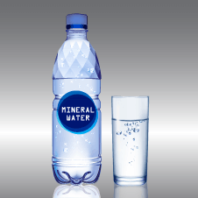
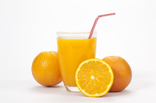
drink: đồ uống
orange juice: nước cam
water: nước
milk: sữa

Slide 10
food:
beef:
pork:
fish:
drink:
orange juice:
milk:
water:
thức ăn
thịt bò
thịt lợn
cá, món cá
đồ uống
nước cam
sữa
nước

Slide 11
MODEL SENTENCES
What’s your favourite food?
It’s chicken.
What’s your favourite drink?
It’s orange juice.

Slide 12
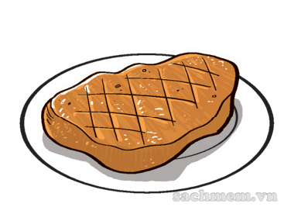
2. Point and say
food/beef
What’s your favourite _______?
It’s _______.

Slide 13
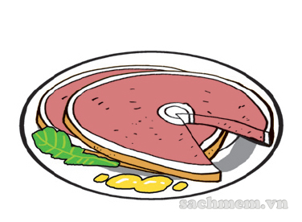
food/pork
What’s your favourite _______?
It’s _______.

Slide 14

drink/orange juice
What’s your favourite _______?
It’s _______.

Slide 15
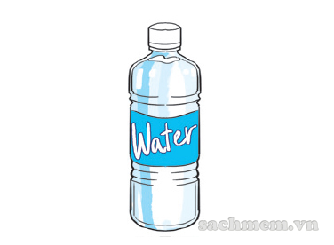
drink/water
What’s your favourite _______?
It’s _______.

Slide 16
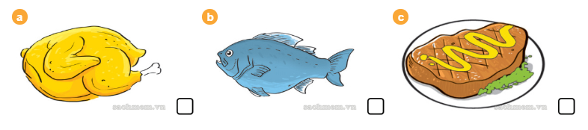

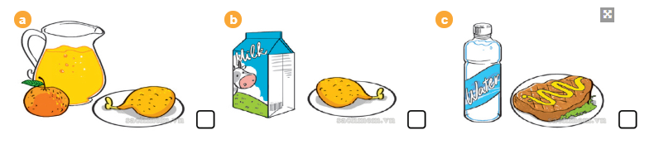
1.What's his favourite food?
2.What's his favourite drink?
What is her favourite food and drink?

Slide 17
Unit 13: Lesson 2(1,2,3,5)
–P20,21

Slide 18
NEW WORDS

Slide 19
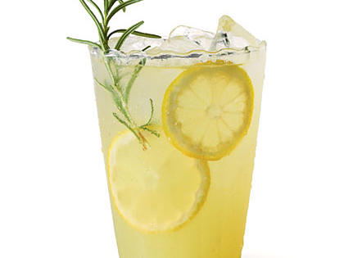
lenonade: nước chanh

Slide 21
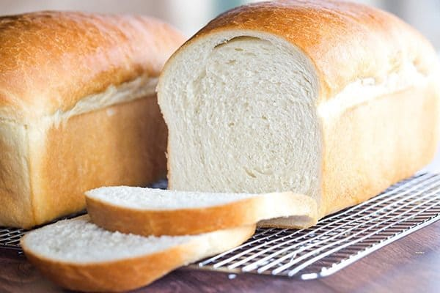
bread: bánh mì

Slide 22
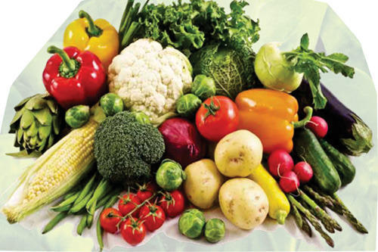
vegetable: rau

Slide 23
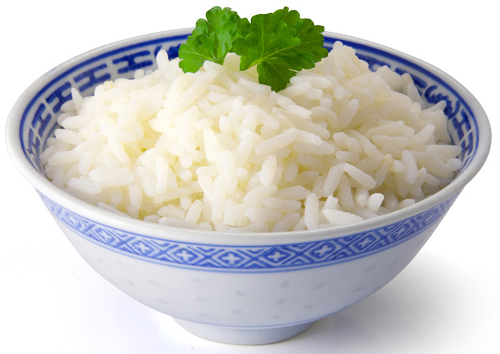
rice: cơm

Slide 24
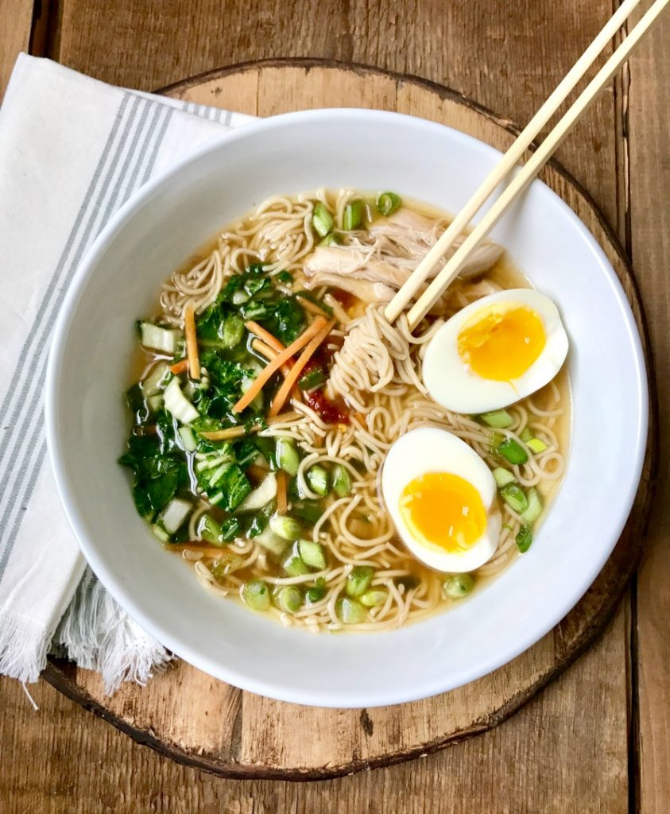
noodle: phở

Slide 25
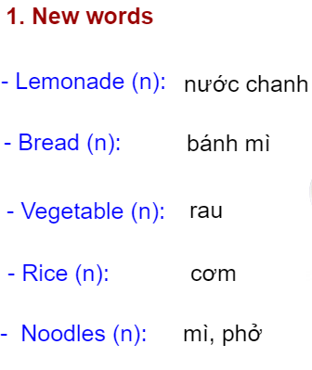

Slide 26
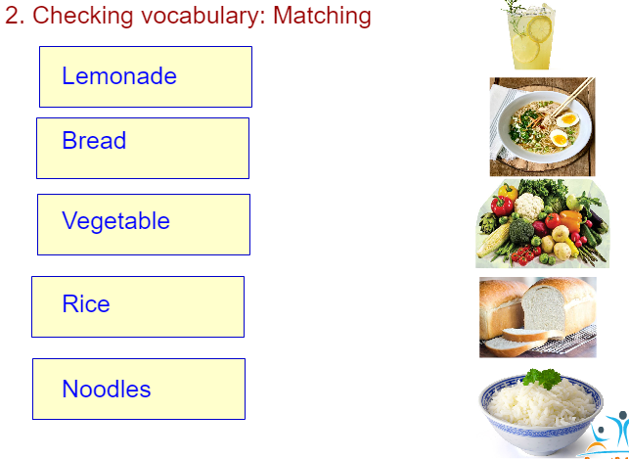

Slide 27
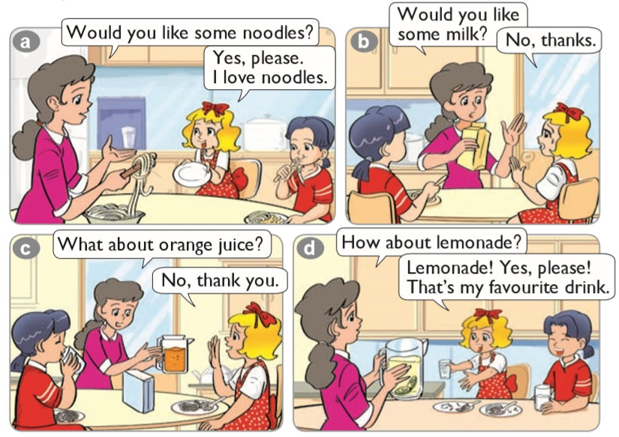

1. Look, listen and repeat

Slide 28
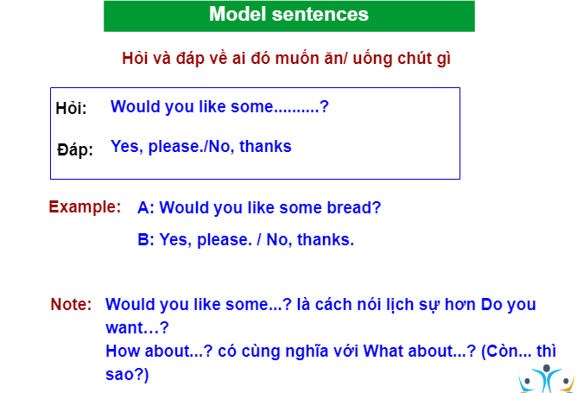

Slide 29
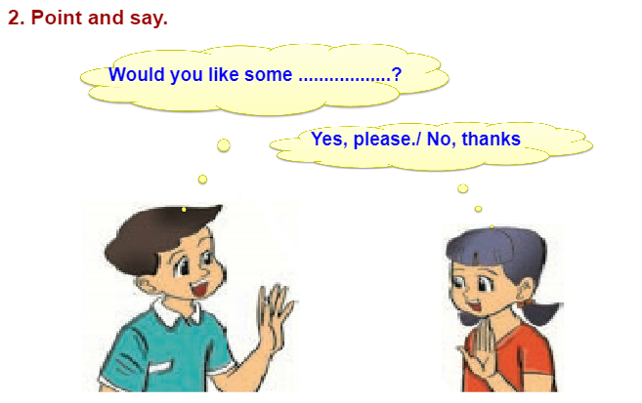
2. Point and say

Slide 30
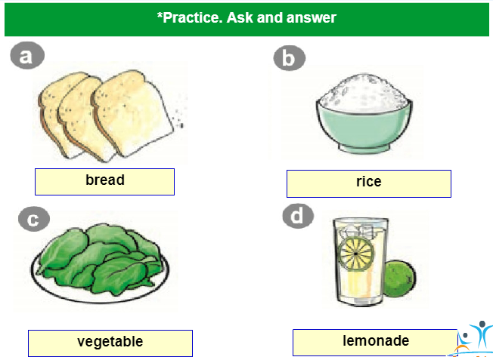

Slide 31
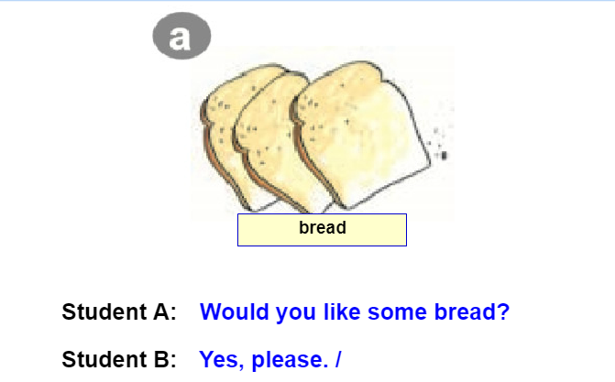

Slide 32
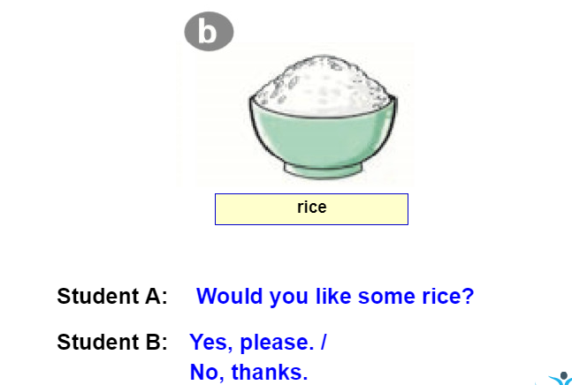

Slide 33
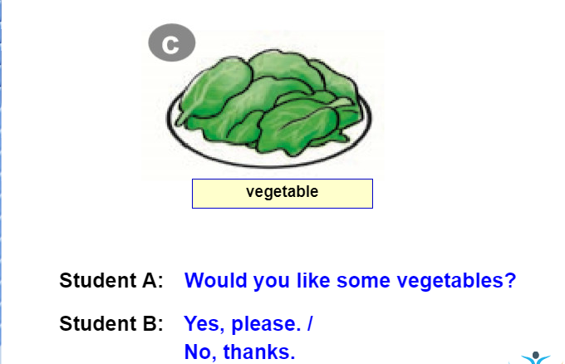

Slide 34
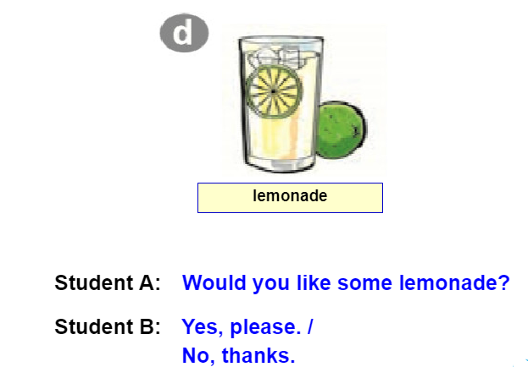

Slide 35
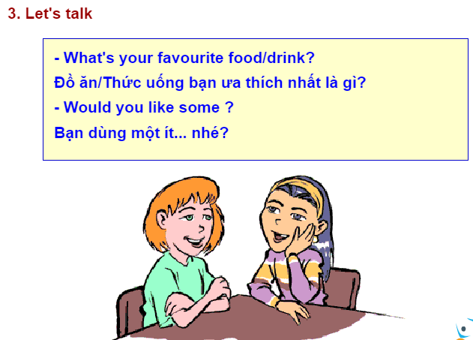

Slide 36
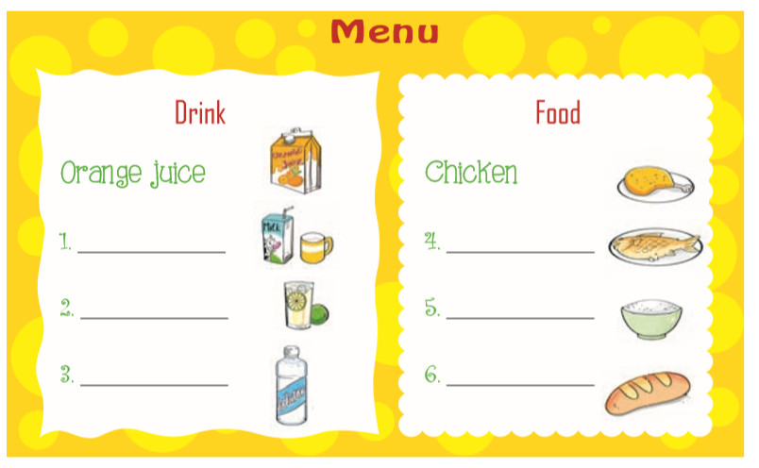
5. Look and write
milk
fish
lemonade
rice
water
bread

