Slide 1
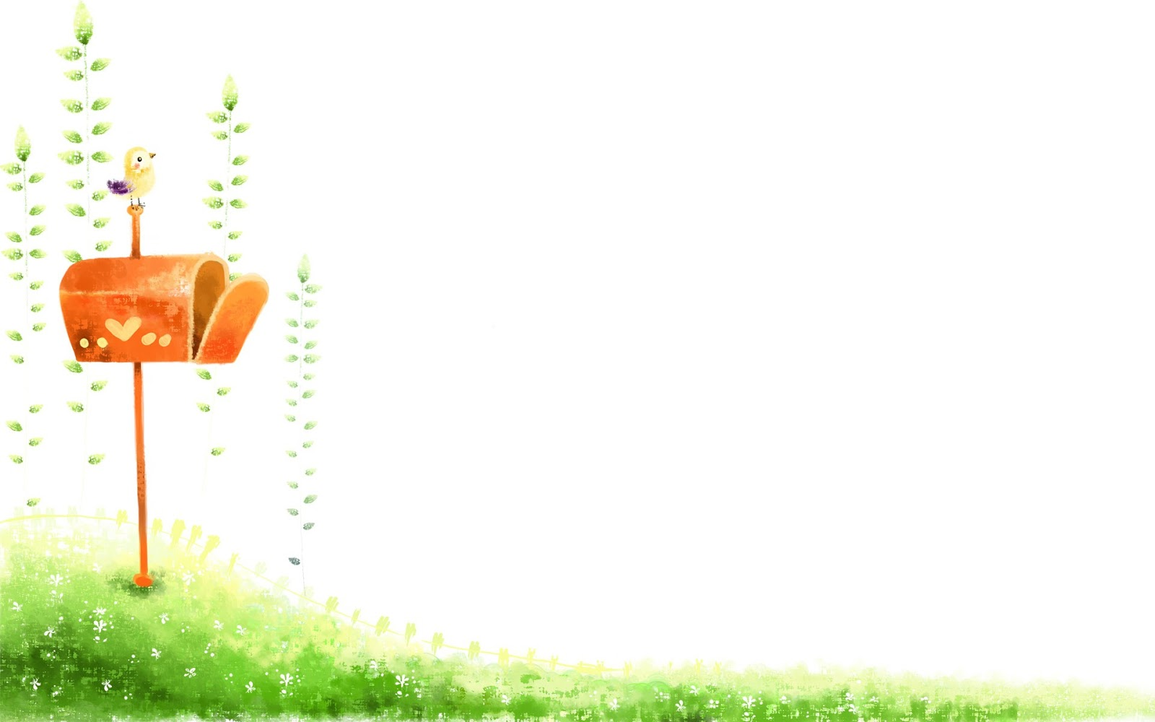
Gia Khanh Primary school Grade 5
Unit 13
What do you do in your free time?
Lesson: 1 (1,2,3)

Slide 2
Monday, April 20th 2020.
Unit 13: Lesson 1 (1,2,3)
1. Look, listen and repeat

Slide 3
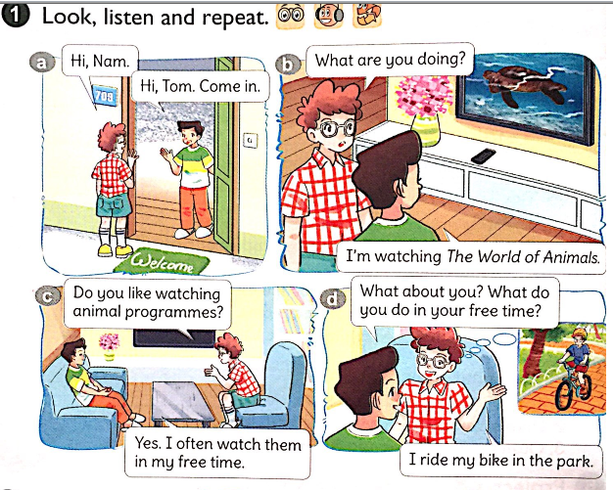
Lesson 1
What do you do in your free time?

Slide 4
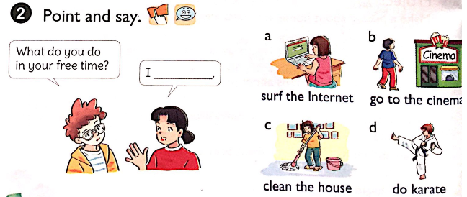
Unit 13: What do you do I your free time?
What do you do in your free time?
I
clean the house.
do karate.
surf the Internet.
go to the cinema.

Slide 5
3. Let's talk
Ask and answer questions about what you and your friends do in your free time.
Do you like ……… ?
Yes, I do
No, I don’t
What do you do in your free time ?
I ………………………

Slide 6
What do you do in your free time? I____

Slide 7
What do you do in your free time? I____

Slide 8
What do you do in your free time? I____

Slide 9
What do you do in your free time? I____

Slide 10
What do you do in your free time? I____

Slide 11
What do you do in your free time? I____

Slide 12
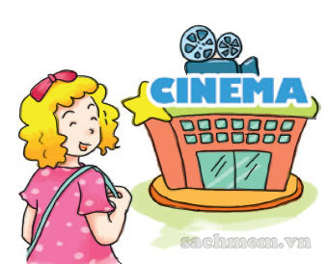
What do you do in your free time? I____

Slide 13
What do you do in your free time? I____

Slide 14
1.The sport of moving on ice (/the ground) on skates.
2. You use hands and feet as weapons in fighting.
3. The sport or business of catching fish.
4.You go to stores and buy things.
5. You go to this building to watch films.
6. You live in a tent on holiday.

Slide 15
My dad and I have the same hobby. We both like fishing very much because it is a quiet sport. There are a lot of big trees around quiet ponds and rivers in our neighbourhood. We often go fishing there. Dad and I can sit for hours to wait for the fish. We often talk about my study or our relatives.

Slide 16
Monday, April 20th 2020.
Unit 13: Lesson 1 (1,2,3)
Look, listen and repeat
Hỏi- đáp bạn thường làm gì vào thời gian rảnh?
What do you do in your free time?
I ride my bike.
2. Point and say
surf the Internet: lướt mạng
do karate: tập võ
go to the cinema:đi xem phim
clean the house: lau nhà
3. Let’s talk

