Slide 1








G
O
M
R
I
G
O
D
N
O
N
!
Gia Khanh Primary School
Welcome to
our class 3

Slide 2
Tuesday, April 21st 2020.
UNIT 12: LESSON 3 (4, 5)

Slide 3


Let's play
Slap the board

Slide 4
kitchen
bedroom
bathroom
garden
living room
house

Slide 5
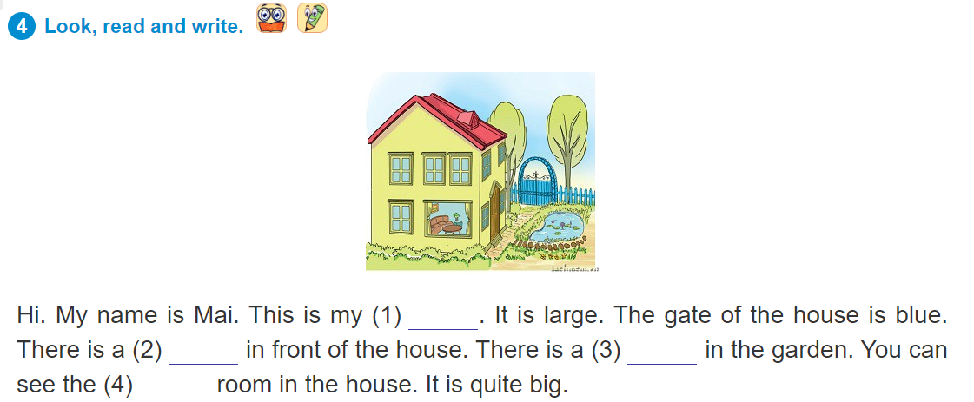
house
garden
pond
living

Slide 6
5. Read again and answer the question
1.Is Mai's house small?
No, It isn't.
2.What colour is the gate?
It's blue.
3.Is there a garden?
Yes, there is.
4.Is there a pond in the garden?
Yes, there is.
5.Is there a yard?
No, there isn't.

Slide 8
Unit 13 – Lesson 1 (1,2,3)

Slide 9

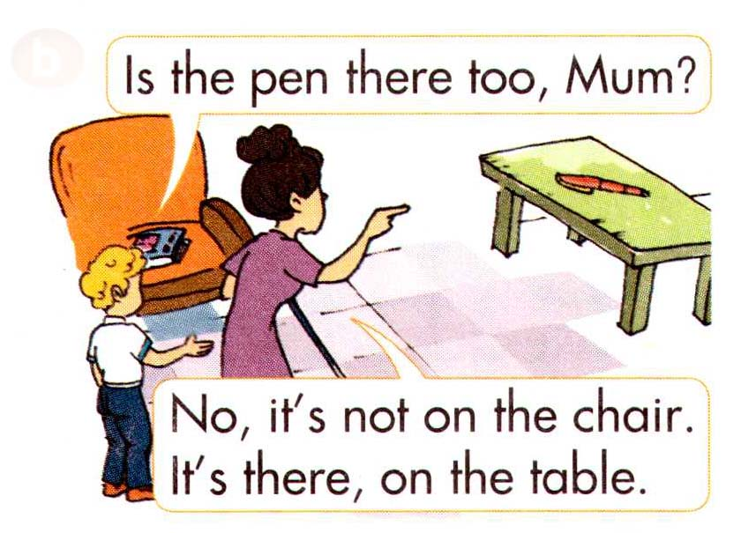
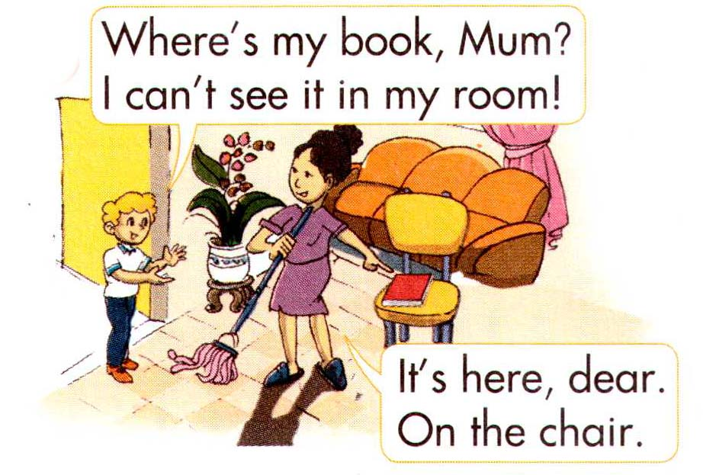
1. Look, listen and repeat

Slide 10
Hỏi - đáp vật ở đâu?
Where’s my book?
It’s on the table

Slide 11
NEW WORD

Slide 12

Ball: quả bóng

Slide 13
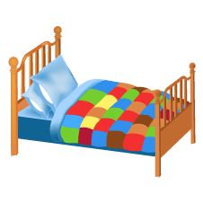
bed: cái giường

Slide 14
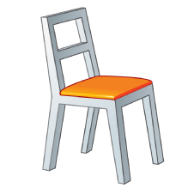
Chair:chiếc ghế

Slide 15
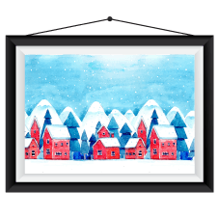
Picture: bức tranh

Slide 16

Poster: áp phích

Slide 17
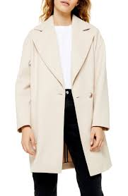
coat: áo choàng

Slide 18
where: ở đâu
there: ở đó
ball: quả bóng
chair: cái ghế
picture: bức tranh
poster: áp phích
coat: áo choàng

Slide 19
Checking Vocabulary
where:
there:
ball:
chair:
picture:
poster:
coat:
ở đâu
ở đó
quả bóng
cái ghế
bức tranh
áp phích
áo choàng

Slide 20
1. Look, listen and repeat

Slide 21
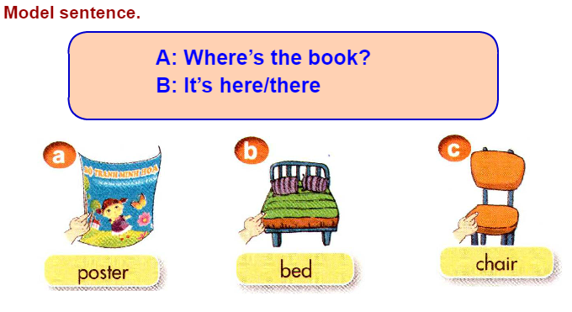
2. Point and say

Slide 22
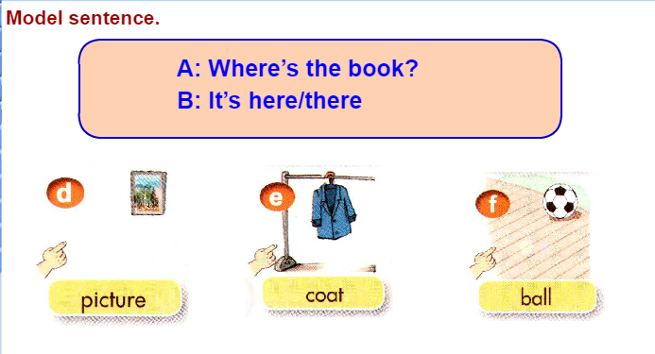

Slide 23
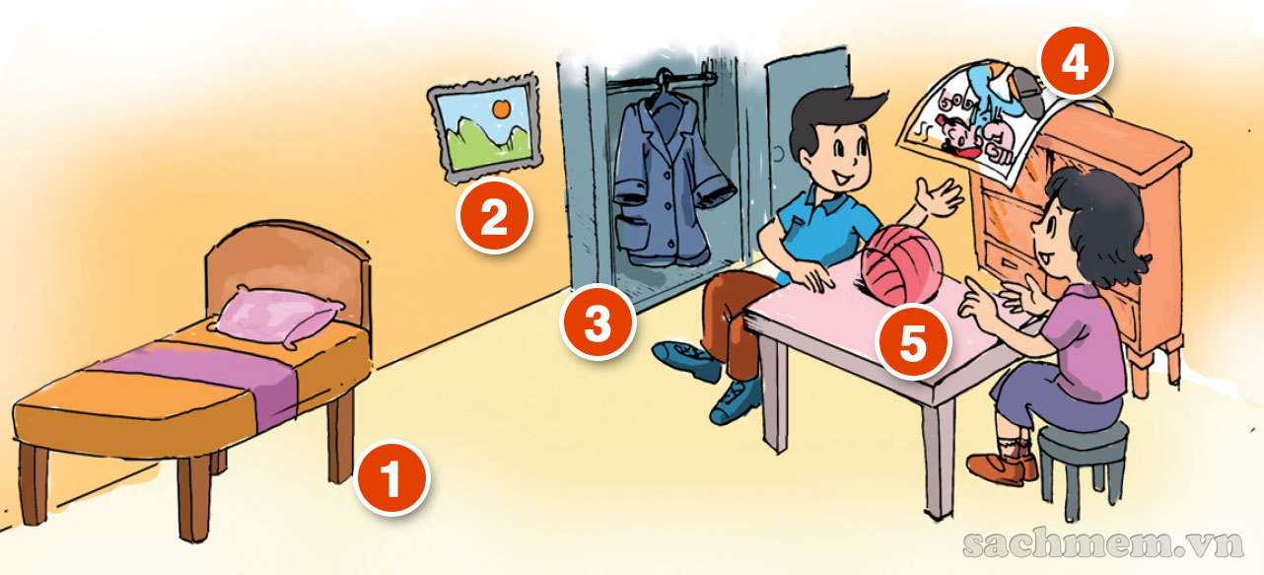
3. Let’s talk

Slide 25
